Slide 1


Post-Graduate Diploma in ML/AI
#LifeKoKaroLift
1
26-10-2020

Slide 2



Course : Machine Learning Lecture On : Pre exam session Instructor : Harish Kumar
EEdditit MMaastesterr tetexxtt stystylesles
26-10-2020
2

Slide 3
Modules Included
Advanced Regression
Model Selection
Tree Models
Boosting
Clustering
26-10-2020
3

Slide 5
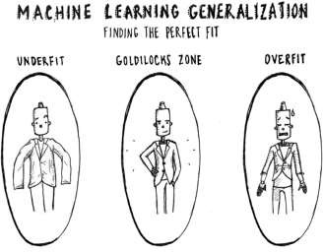
What & Why of Overfitting and Underfitting
Underfitting refers to a model that can neither model the training data nor generalize to new data.
An underfit machine learning model is not a suitable model and will be obvious as it will have poor performance
on the training data.
Overfitting refers to a model that models the training data too
well.
Overfitting happens when a model learns the detail and noise in the training data to the extent that it negatively impacts the performance of the model on new data. This means that the noise or random fluctuations in the training data is picked up and learned as concepts by the model. The problem is that these concepts do not apply to new data and negatively impact the models ability to generalize.
26-10-2020
5

Slide 6
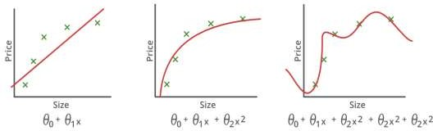
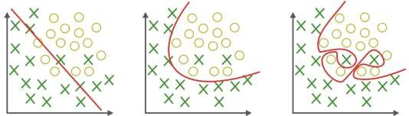
What & Why of Overfitting and Underfitting
Underfitting
Good-Fit
Overfitting
26-10-2020
6

Slide 7
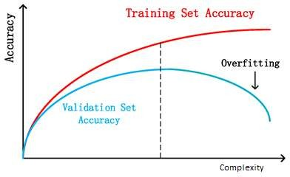
How to Detect Overfitting?
Detecting overfitting is almost impossible before you test the data. It can help address the inherent characteristic of overfitting, which is the inability to generalize data sets. The data can, therefore, be separated into different subsets to make it easy for training and testing. The data is split into three main parts, i.e., a train set ,a test set & a validate set
Training set: A set of examples used for learning, that
is to fit the parameters of the classifier.
Validation set: A set of examples used to tune the parameters of a classifier, for example to choose the number of hidden units in a neural network.
Test set: A set of examples used only to assess the
performance of a fully-specified classifier.
By segmenting the dataset, we can examine the performance of the model on each set of data to spot overfitting when it occurs. The performance can be measured using the percentage of accuracy observed in train & validate data sets to conclude on the presence of overfitting.
26-10-2020
7

Slide 8



CPloilclk1to add Title
How does number of observations influence overfitting? Choose the correct answer(s)
In case of fewer observations, it is easy to overfit the data.
In case of fewer observations, it is hard to overfit the data.
In case of more observations, it is easy to overfit the data.
In case of more observations, it is hard to overfit the data
A. 1 and 4
B. 2 and 3
Practice in teams of 4 students
Industry expert mentoring to learn better
Get personalised feedback for improvements
C. 1 and 3
D. None of theses
26-10-2020
Footer
11
8

Slide 9
CPloilclk1to add Title
How does number of observations influence overfitting? Choose the correct answer(s)
In case of fewer observations, it is easy to overfit the data.
In case of fewer observations, it is hard to overfit the data.
In case of more observations, it is easy to overfit the data.
In case of more observations, it is hard to overfit the data
A. 1 and 4
B. 2 and 3
Practice in teams of 4 students
Industry expert mentoring to learn better
Get personalised feedback for improvements
C. 1 and 3
D. None of theses
26-10-2020
Footer
11
9

Slide 10
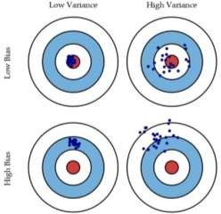
Bias and Variance in regression models
The prediction error for any machine learning algorithm
can be broken down into three parts:
Bias Error
Variance Error
Irreducible Error
The irreducible error cannot be reduced regardless of what algorithm is used. It is the error introduced from the chosen framing of the problem and may be caused by factors like unknown variables that influence the mapping of the input variables to the output variable.
Low Bias: Suggests less assumptions about the form of the target function.
High-Bias: Suggests more assumptions about the form of the target function.
Low Variance: Suggests small changes to the estimate of the target function with changes to the training dataset.
High Variance: Suggests large changes to the estimate of the target function with changes to the training dataset.

Slide 12
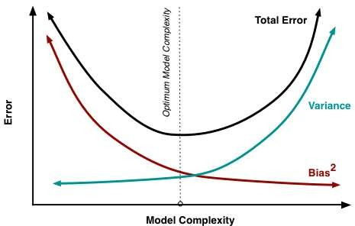
Bias-Variance Trade-Off
The goal of any supervised machine learning algorithm is to achieve low bias and low variance. In turn the
algorithm should achieve good prediction performance.
Parametric or linear machine learning algorithms often have a high bias but a low variance.
Non-parametric or non-linear machine learning
algorithms often have a low bias but a high variance.
The parameterization of machine learning algorithms is often a battle to balance out bias and
variance.

Slide 13
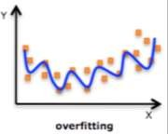
Regularized Linear Regression
One of the major aspects of training your
machine learning model is avoiding
overfitting. The model will have a low accuracy if it is overfitting. This happens because your model is trying too hard to capture the noise in your training dataset.
Regularization
This is a form of regression, that constrains/ regularizes or shrinks the coefficient estimates towards zero. In other words, this technique discourages learning a more complex or flexible model, so as to avoid the risk of overfitting.

Slide 15
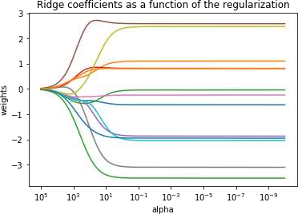

Ridge Regression
RSS is modified by adding the shrinkage quantity.
Now, the coefficients are estimated by minimizing this function. Here, λ is the tuning parameter that decides how much we want to penalize the flexibility of our model.
The increase in flexibility of a model is represented by increase in its coefficients, and if we want to minimize the above function, then these coefficients need to be small.

Slide 16
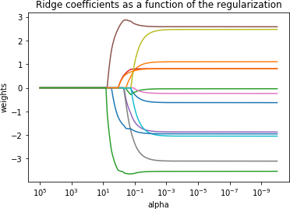

Lasso Regression
Lasso is another variation, in which the above
function is minimized. Its clear that
this variation differs from ridge regression
only in penalizing the high coefficients.

Slide 17
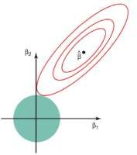
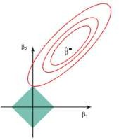
Regularized Linear Regression
The ridge regression is expressed by β1² + β2² ≤ s. This implies that ridge regression coefficients have the smallest RSS(loss function) for all points that lie within the circle given by β1² + β2² ≤ s
The lasso, the equation becomes,|β1|+|β2|≤ s. This implies that lasso coefficients have the smallest RSS(loss function) for all points that lie within the diamond given by |β1|+|β2|≤ s.

Slide 18
Model Evaluation
A confusion matrix shows the number of correct and incorrect predictions made by the classification model compared to the actual outcomes (target value) in the data. The matrix is NxN, where N is the number of target values (classes). Performance of such models is commonly evaluated using the data in the matrix. The following table displays a 2x2 confusion matrix for two classes (Positive and Negative).
Accuracy : the proportion of the total number of predictions that were correct.
Positive Predictive Value or Precision : the proportion of positive cases that were correctly identified.
Negative Predictive Value : the proportion of negative cases that were correctly identified.
Sensitivity or Recall : the proportion of actual positive cases which are correctly identified.
Specificity : the proportion of actual negative cases which are correctly identified.
Target
Confusion Matrix
 | Positive | Negative
Positive | a | b | Positive Predictive Value | a/(a+b)
Negative | c | d | Negative Predictive Value | d/(c+d)
 | Sensitivity | Specificity | Accuracy = (a+d)/(a+b+c+d)
26-10-2020
18

Slide 19
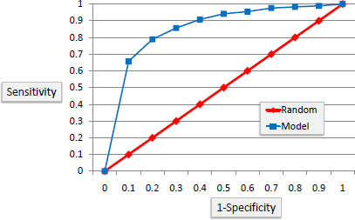



Model Evaluation
ROC Curves summarize the trade-off between the true positive rate and false positive rate for a predictive model using different probability thresholds
It’s often used as a proxy for the trade-off between the sensitivity of the model (true positives) vs the fall- out or the probability it will trigger a false alarm (false positives).
https://en.wikipedia.org/wiki/Confusion_matrix
26-10-2020
19

Slide 20
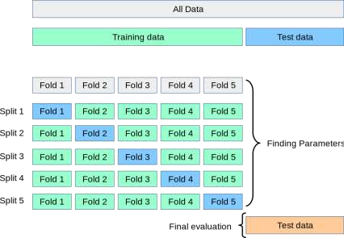
Cross Validation
Cross-validation is a resampling technique used to evaluate machine learning models on a limited data set.
The most common use of cross-validation is the k-fold cross-validation method. Our training set is split into K partitions, the model is trained on K-
1 partitions and the test error is predicted and computed on the Kth partition. This is repeated for each unique group and the test errors are averaged across.

Slide 21
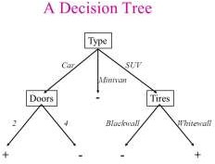
Decision Tree
Decision tree is the most powerful and popular tool for classification and prediction. A Decision tree is a flowchart like tree structure, where each internal node denotes a test on an attribute, each branch represents an outcome of the test, and each leaf node (terminal node) holds a class label.

Slide 22
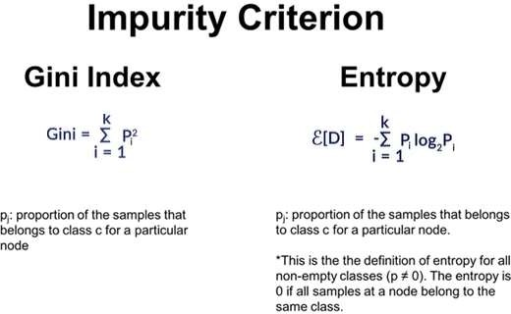
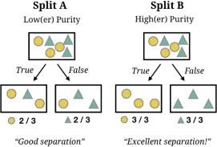
where to split ?

Slide 23
When to stop splitting?
As a problem usually has a large set of features, it results in large number of split, which in turn gives a
huge tree. Such trees are complex and can lead to overfitting.
Pruning
Truncation
Remove the branches that make use of features having low importance.This way, we reduce the complexity of tree, and thus increasing its predictive power by reducing overfitting.
Stop the tree wile it is still growing so that it may not end up with leaves containing vary less data-points, one way to do this is by setting the minimum number

Slide 24
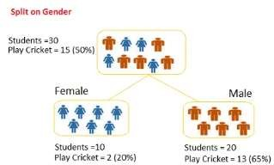
CPloilclk4to add Title
Question: we want to segregate the students based on target variable (playing cricket or not).we split the population using input variables Gender find the homogeneity of sub-nodes using Gini.
A) 0.51
B) 0.59
C) 0.33
D) 0.49
Practice in teams of 4 stude Industry expert mentoring to l Get personalised feedback fo
nts
earn better
r improvements
26-10-2020
Footer
11
24

Slide 25
CPloilclk4t(oSaodludtiTointl)e
Question: we want to segregate the students based on target variable (playing cricket or not).we split the population using input variables Gender find the homogeneity of sub-nodes using Gini.
A) 0.51
B) 0.59
C) 0.33
D) 0.49
Practice in teams of 4 st
Industry expert mentorin
udents
g to learn better
Get personalised feedback for improvements
Calculate, Gini for sub-node Female = (0.2)*(0.2)+(0.8)*(0.8)=0.68
Gini for sub-node Male = (0.65)*(0.65)+(0.35)*(0.35)=0.55
Calculate weighted Gini for Split Gender = (10/30)*0.68+(20/30)*0.55 = 0.59
26-10-2020
Footer
11
25

Slide 27
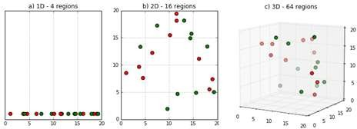
What is the curse of dimensionality?
Sparsity of data occurs when moving to higher dimensions. the volume of the space represented grows so quickly that the data cannot keep up and thus becomes sparse
The second issue that arises is related to sorting or classifying the data. In low dimensional spaces, data may seem very similar but the higher the dimension the data points may seem far.
Infinite Features Requires Infinite Training
A careful choice of the number of dimensions (features) to be used is the
prerogative of the data scientist training the Model

Slide 29
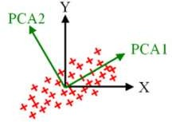
What is Principal Components Analysis?
Principal Components Analysis is an unsupervised learning class of statistical techniques used to explain data in high dimension using smaller number of variables called the principal components.
The loading vector Ф₁ with elements Ф₁₁, Ф₂₁,…,Ф_{p1} defines a direction in the feature space along which there
is maximum variance in the data.
Thus, if we are to project the n data points x₁, x₂,…, x_{n}
onto this direction, then projected values are the actual principal component scores z₁₁, z₂₁, …, z_{n1}.
After the first principal components, Z₁ of the features has been determined, then the second principal component is the linear combination of X₁, ,X₂,… X_{p} that has the highest variance out of all the linear combinations that are uncorrelated with Z₁. The second principal component scores z₁₂, z₂₂,…,z_{n2} take the form

Slide 30
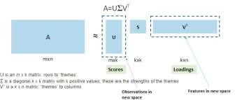
PCA
PCA is useful when you have a large number of potentially correlated variables. Also, PCA can be
used to visualize complex datasets.
We saw that if each row in the original dataset A (m x n) represents a user and each column an item
such as a book, then:
The matrix U (m x k) maps the users to the new k themes/latent variables
The diagonal matrix S (k x k) represents the strength of each feature
Matrix V' (k x n) maps each of the k themes/latent variables to the original n features.
26-10-2020
18

Slide 31
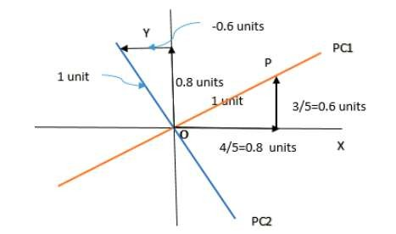
CPloilclk5to add Title
What are the PC1 and PC2 values for given x=3 and y=2 ?
A) 3.4 & 1.2
B) 3.6 & -0.2
C) 3.4 & -0.2
D) 3.6 & 1.2
Practice in team
Industry expert m
s of 4 students
entoring to learn better
Get personalised feedback for improvements
26-10-2020
Footer
11
31

Slide 32
CPloilclk5t(oAandswdeTri)tle
What are the PC1 and PC2 values for given x=3 and y=2 ?
A) 3.4 & 1.2
B) 3.6 & -0.2
C) 3.4 & -0.2
D) 3.6 & 1.2
Practice in team
Industry expert m
s of 4 students
entoring to learn better
Get personalised feedback for improvements
26-10-2020
Footer
11
32

Slide 33
CLUSTERING
K-Mean Clustering
The number of clusters that you want to divide your data points into, i.e. the value of K has to be pre-determined.
The choice of the initial cluster centers can have an impact on the final cluster formation.
The clustering process is very sensitive to the presence of outliers in the data.
Since the distance metric used in the clustering process is the Euclidean distance, you need to bring all your
attributes on the same scale. This can be achieved through standardization.
The K-Means algorithm does not work with categorical data.
Choosing the number of clusters K
Elbow method
Compute clustering algorithm (e.g., k-means clustering) for different values of k. For instance, by varying k from 1 to 10
clusters.
For each k, calculate the total within-cluster sum of square (wss)
Plot the curve of wss according to the number of clusters k.
The location of a bend (knee) in the plot is generally considered as an indicator of the appropriate number of clusters.
26-10-2020
19

Slide 34
CLUSTERING
Hierarchical Clustering algorithm
Given a set of N items to be clustered, the steps in the hierarchical clustering are:
Calculate the NxN distance (similarity) matrix, which calculates the distance of each data point from the other.
Start by assigning each item to its own cluster, so that if you have N items, you now have N clusters, each
containing just one item.
Find the closest (most similar) pair of clusters and merge them into a single cluster, so that now you have one less cluster.
Compute distances (similarities) between the new cluster and each of the old clusters.
Repeat steps 3 and 4 until all items are clustered into a single cluster of size N
Single Linkage
Here, the distance between 2 clusters is defined as the shortest distance between points in the two clusters
Complete Linkage
Here, the distance between 2 clusters is defined as the maximum distance between any 2 points in the clusters
Average Linkage
Here, the distance between 2 clusters is defined as the average distance between every point of one cluster to every other point
of the other cluster.
26-10-2020
20

Slide 35
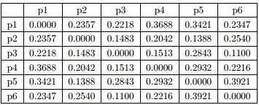
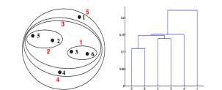
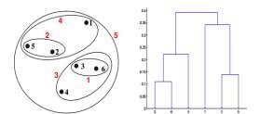
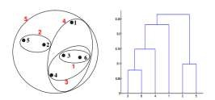
^{Po}C^{l}l^{l}i⁶ck to add Title
Which of the following clustering representations and dendrogram depicts the use of MIN or Single link proximity function in hierarchical clustering?
Distance Matrix
Practice in teams of 4 students
Industry expert mentoring to learn better
Get personalised feedback for improvements
(A)
(B)
Footer
(C)
26-10-2020
11
35

Slide 36
^{Po}C^{l}l^{l}i⁶ck^{(A}to^{ns}a^{w}d^{e}d^{r)}Title
Which of the following clustering representations and dendrogram depicts the use of Single link proximity function in hierarchical clustering?
Distance Matrix
Practice in teams of 4 students
Industry expert mentoring to learn better
Get personalised feedback for improvements
(A)
(B)
Footer
(C)
26-10-2020
11
36

Slide 37
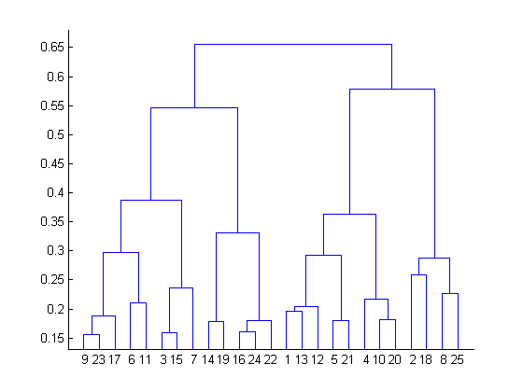
CPloilclk7to add Title
What is the most appropriate no. of clusters for the data points represented by the following dendrogram?
2
4
6
8
Practice in teams of 4 students
Industry expert mentoring to learn better
Get personalised feedback for improvements
26-10-2020
Footer
11
37

Slide 38
CPloilclk7t(oAandswdeTri)tle
What is the most appropriate no. of clusters for the data points represented by the following dendrogram?
2
4
6
8
Practice in teams of 4 students
Industry expert mentoring to learn better
Get personalised feedback for improvements
26-10-2020
Footer
11
38

Slide 39
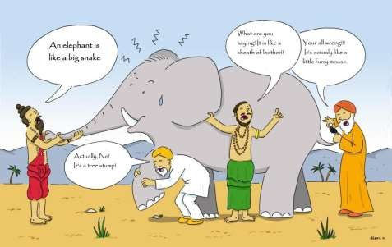
Ensemble methods
Ensemble learning is a machine learning paradigm where multiple models (often called “weak learners”) are trained to solve the same problem and combined to get better results.
https://towardsdatascience.com/ensemble-methods-bagging-boosting-and-stacking-c9214a10a205

Slide 40
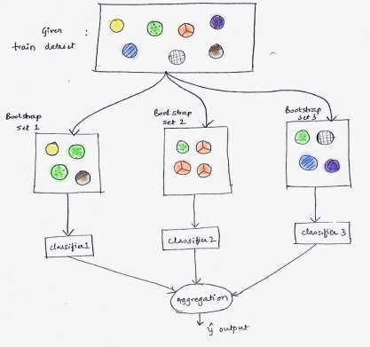
Bagging
Bagging, that often considers homogeneous weak learners, learns them independently from each other in parallel and combines them following some kind of deterministic averaging process
https://learn.upgrad.com/v/course/515/session/77070/segment/431269

Slide 41
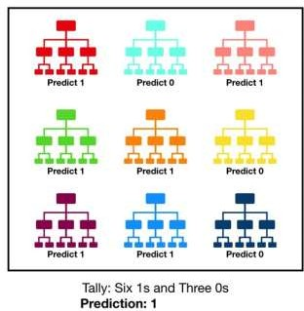
Random Forest
Random forest, like its name implies, consists of a large number of individual decision trees that operate as
an ensemble. Each individual tree in the random forest spits out a class prediction and the class with the most votes becomes our model’s prediction
The reason for this wonderful effect is that the trees protect each other from their individual errors (as long as they don’t constantly all err in the same direction)

Slide 42
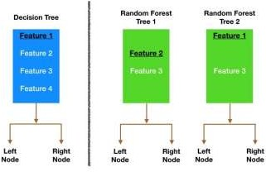
Random Forest
Bagging (Bootstrap Aggregation) — Decision trees are very sensitive to the data they are trained on — small changes to the training set can result in significantly different tree structures. Random forest takes advantage of this by allowing each individual tree to randomly sample from the dataset with replacement, resulting in different trees.
Feature Randomness — In a normal decision tree, while splitting a node, we consider all the features and pick the one that produces the most separation. In contrast, each tree in a random forest can pick only from a random subset of features. This forces even more variation amongst the trees in the model and ultimately results in lower correlation across trees and more diversification.

Slide 43
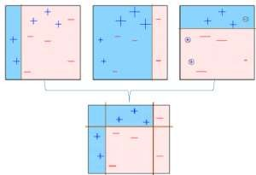

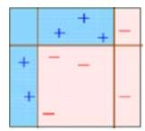

Different ensemble methods
The observations which are incorrectly predicted, are given higher weights and an another model is created and
Base model is
created on a subset
. The individual models would not perform well on the entire dataset, but they work well for some part of the dataset. Thus, each model actually boosts the performance of the ensemble.
predictions are made
on the dataset
multiple models are created, each correcting the errors of the previous model.
The final model (strong learner)
Boosting, that often considers homogeneous weak learners, learns them sequentially in a very adaptive way (a base model depends on the
previous ones) and combines them following a deterministic strategy
https://medium.com/mlreview/gradient-boosting-from-scratch-1e317ae4587d

Slide 44
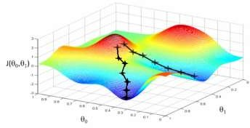
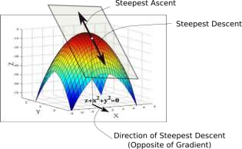
Gradient Descent
While the direction of the gradient tells us which direction has the steepest ascent, it's magnitude tells us how steep the steepest ascent/descent is. So, at the minima, where the contour is almost flat, you would expect the gradient to be almost zero. In fact, it's precisely zero for the point of minima.
Gradient descent is an optimization algorithm used to minimize some function by iteratively moving in the direction of steepest descent as defined by the negative of the gradient

Slide 45
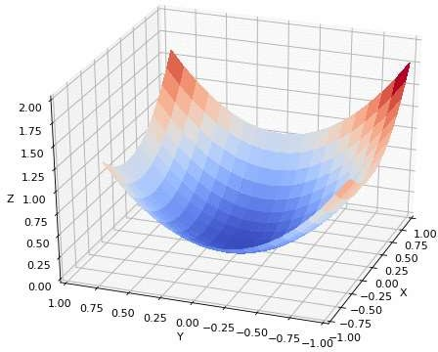
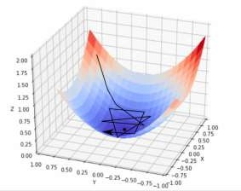
Gradient Descent
In practice, we might never exactly reach the minima, but we keep oscillating in a flat region in close vicinity of the minima. As we oscillate our this region, the loss is almost the minimum we can achieve, and doesn't change much as we just keep bouncing around the actual minimum.
Often, we stop our iterations when the loss values haven't improved in a pre-decided number, say, 10, or 20 iterations. When such a thing happens, we say our training has converged, or convergence has taken place.

Slide 46

Thank You!
#LifeKoKaroLift
21
26-10-2020

